Slide 1
Humboldt Transit Pocket Planner Application
Jeremy Walker

Slide 2
Motivation
Unpredictable times in when a bus will arrive at a certain stop.
Had many people ask me when the next bus comes, or if a bus has already passed.
Reading the times for different transit routes and direction schedules can be convolutied and a hassle.
Free wifi is available in the transit buses.
It would be useful and easier to know if a bus is early or late, so you can plan accordingly from your current location.

Slide 3
Proposal
To develop an Android application that allows for a convenient and easy to use interface to plan public transit.
To integrate the known and established transit system schedules, but provide a more organized and user friendly experience.

Slide 4
App Features
Allows users to plan their transit schedule based on closest transit stops, or desired locations.
Users can track the location, route, and arrival time of desired bus.
Updates user on bus delays, or alternative methods of transportation to get to their desired location more efficiently.
Plan a transit route with interconnection between various transit systems.
Comparison on price, trip and arrival time from taking/waiting for the bus or walking/riding bike/etc.
Google Maps API for navigation, location, etc.
Access to a database to make requests for queries regarding certain bus schedules.

Slide 5
Phone Requirements
An Android device with at least Android 4.4 Kit Kat (minimum).
An Android device with gyroscope/compass, wifi or data capabilities, accelerarometer, GPS.
At least 512 Mb of RAM storage.
Device storage to be specified.

Slide 6
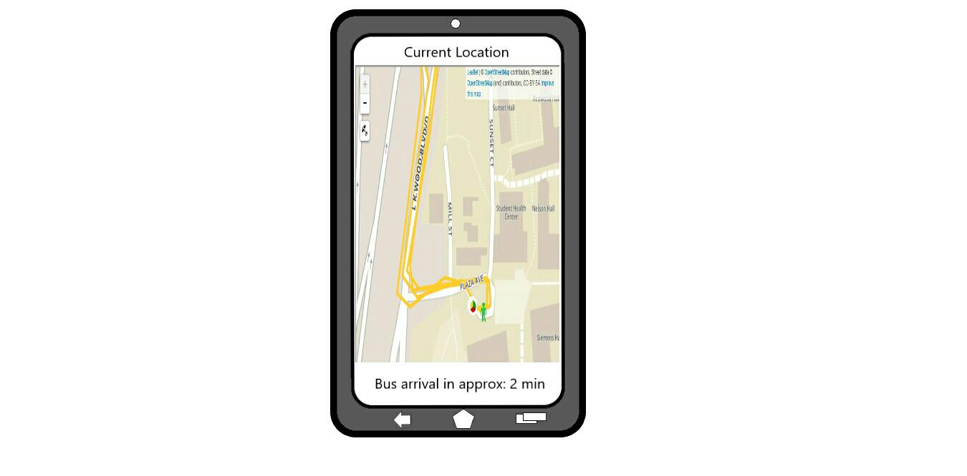
Mockups

Slide 7
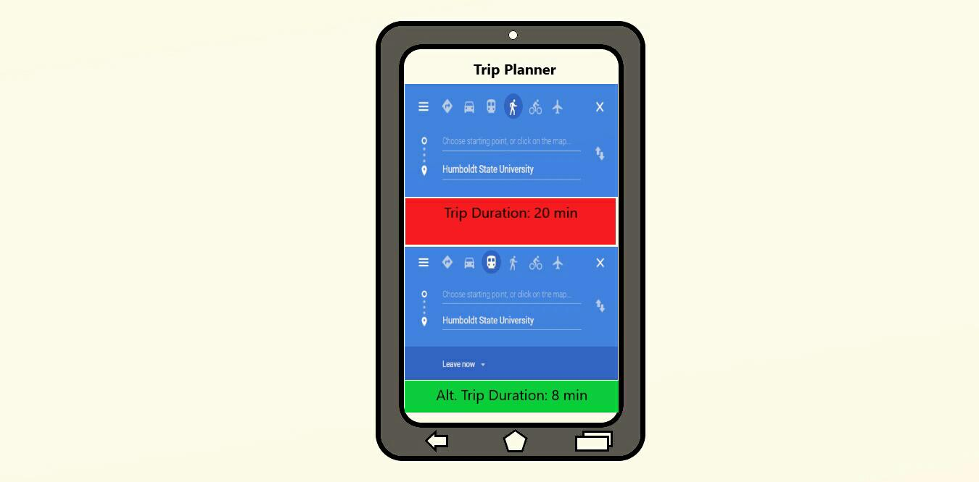
Mockups

Slide 8
Project Timeline
March 4-8: Brainstorm and map potential methods for a successful app
March 8-19: Create and design a organized GUI/UI.
March 12-30: Create prototype database for app to access
March 12-April 30: Code and test (through fieldtesting, Android emulator/device) app functionality/reliability/etc.
Fix any potential issues, test again.
Add more useful features, continue testing.

Slide 9
Anticipated Deliverables
To provide a useful and widespread tool for students/commuters alike to use when on the go
To be able to be used with public transportation systems outside of Humboldt County.
To count as an alternative to cramped printed paper pamphlets , where updates to schedules can be made digitally instead of having to print them again

